Slide 1

Chapter 2
Information System
Building Blocks

Slide 2
Objectives
Differentiate between front- and back-office information systems.
Describe the role of information systems architecture in systems development.
Identify three high-level goals that provide system owners and system users with a perspective of an information system.
Identify three technologies that provide system designers and builders with a perspective of an information system.
Identify three areas of focus for an information system

Slide 3
Objectives (cont.)
Describe four building blocks of the KNOWLEDGE goal for an information system.
Describe four building blocks of the PROCESS goal for an information system.
Describe four building blocks of the COMMUNICATIONS goal for an information system.
Describe the role of network technologies as it relates to Knowledge, Processes, and Communications building blocks.

Slide 4
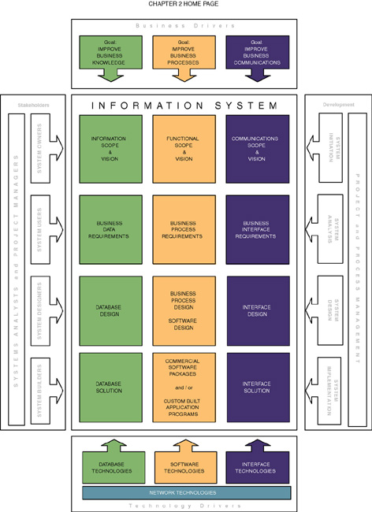

Slide 5
Front- and Back-Office
Information Systems
Front-office information systems support business functions that extend out to the organization’s customers (or constituents).
  Marketing
  Sales
  Customer management
Back-office information systems support internal business operations of an organization, as well as reach out to suppliers (of materials, equipment, supplies, and services).
  Human resources
  Financial management
  Manufacturing
  Inventory control

Slide 6
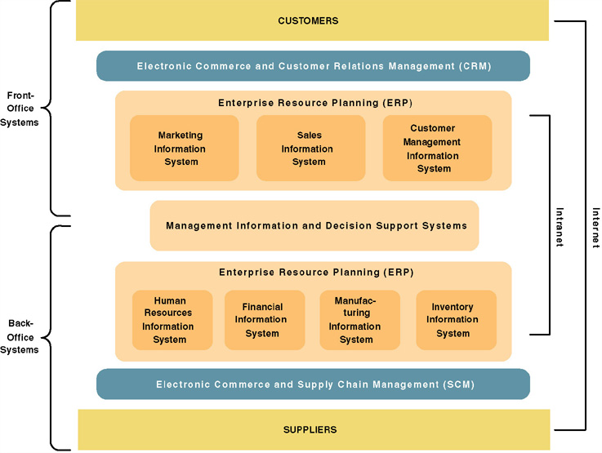
A Federation of
Information Systems

Slide 7
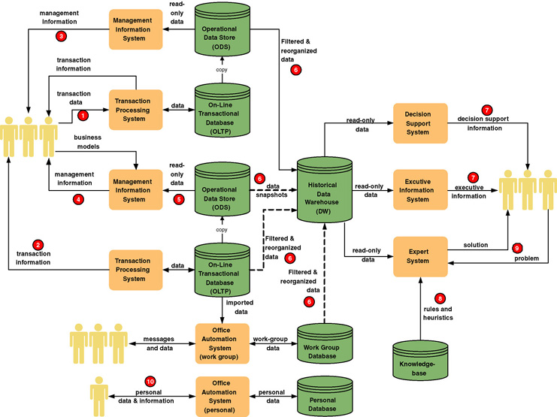
Information System Applications

Slide 8
Information Systems Architecture
Information systems architecture - a unifying framework into which various stakeholders with different perspectives can organize and view the fundamental building blocks of information systems.

Slide 9
High-Level Goals of
System Owners and System Users
Improve business knowledge
Improve business processes and services
Improve business communication and people collaboration

Slide 10
Technology Perspectives of
System Designers & System Builders
Database technologies that support business accumulation and use of business knowledge
Software technologies that automate and support business processes and services
Interface technologies that support business communication and collaboration

Slide 11
Focuses for Information Systems
Knowledge — the raw material used to create useful information.
Process — the activities (including management) that carry out the mission of the business.
Communication — how the system interfaces with its users and other information systems.

Slide 12
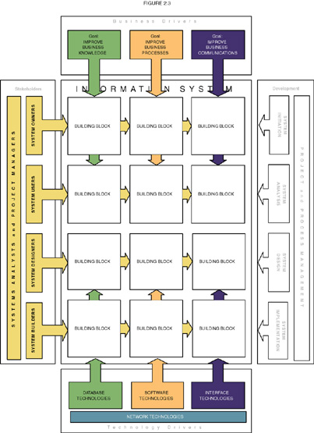
Information System Building Blocks

Slide 13
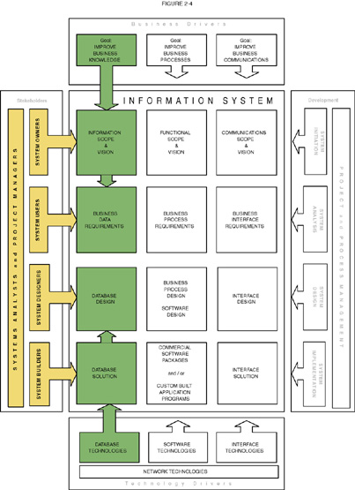
KNOWLEDGE Building Blocks

Slide 14
Views of KNOWLEDGE
System owners’ view
  Interested not in raw data but in information that adds new business knowledge and helps managers make decisions.
  Business entities and business rules.
System users’ view
  View data as something recorded on forms, stored in file cabinets, recorded in books and spreadsheets, or stored on computer.
  Focus on business issues as they pertain to data.
  Data requirement – a representation of users’ data in terms of entities, attributes, relationships, and rules independent of data technology.

Slide 15
Views of KNOWLEDGE (cont.)
System designers’ view
  Data structures, database schemas, fields, indexes, and constraints of particular database management system (DBMS).
System builders’ view
  SQL
  DBMS or other data technologies

Slide 16
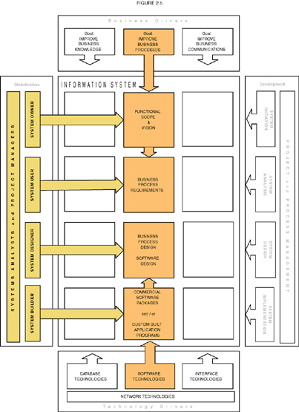
PROCESS Building Blocks

Slide 17
Views of PROCESS
System owners’ view
  Concerned with high-level processes called business functions.
  Business function – a group of related processes that support the business. Functions can be decomposed into other subfunctions and eventually into processes that do specific tasks.
  A cross-functional information system – a system that supports relevant business processes from several business functions without regard to traditional organizational boundaries such as divisions, departments, centers, and offices.

Slide 18
Views of PROCESS (cont.)
System users’ view
  Concerned with work that must be performed to provide the appropriate responses to business events.
  Business processes – activities that respond to business events.
  Process requirements – a user’s expectation of the processing requirements for a business process and its information systems.
  Policy – a set of rules that govern a business process.
  Procedure – a step-by-step set of instructions and logic for accomplishing a business process.
  Work flow – the flow of transactions through business processes to ensure appropriate checks and approvals are implemented.

Slide 19
Views of PROCESS (cont.)
System designers’ view
  Concerned with which processes to automate and how to automate them
  Constrained by limitations of application development technologies being used
  Software specifications – the technical design of business processes to be automated or supported by computer programs to be written by system builders.

Slide 20
Views of PROCESS (cont.)
System builders’ view
  Concerned with programming logic that implements automated processes
  Application program – a language-based, machine-readable representation of what a software process is supposed to do, or how a software process is supposed to accomplish its task.
  Prototyping – a technique for quickly building a functioning, but incomplete model of the information system using rapid application development tools.

Slide 21
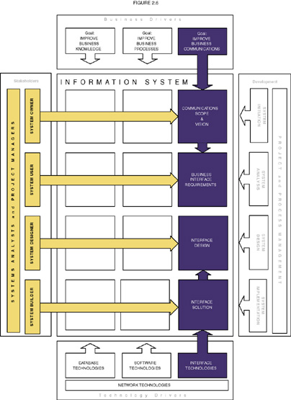
COMMUNICATION Building Blocks

Slide 22
Views of COMMUNICATION
System owners’ view
  Who (which business units, employees, customers, and partners) must interact with the system?
  Where are these business units, employees, customers, and partners located?
  What other information systems will the system have to interface with?
System users’ view
  Concerned with the information system’s inputs and outputs.

Slide 23
Views of COMMUNICATION (cont.)
System designers’ view
  Concerned with the technical design of both the user and the system-to-system communication interfaces.
  Interface specifications – technical designs that document how system users are to interact with a system and how a system interacts with other systems.
  User dialogue – a specification of how the user moves from window to window or page to page, interacting with the application programs to perform useful work.

Slide 24
Views of COMMUNICATION (cont.)
System builders’ view
  Concerned with the construction, installation, testing and implementation of user and system-to-system interface solutions.
  Middleware – utility software that allows application software and systems software that utilize differing technologies to interoperate.

Slide 25
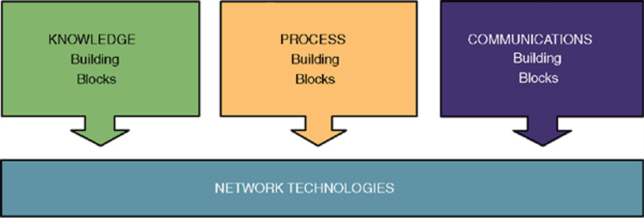
Network Technologies and the
IS Building Blocks
Clean-layering approach allows any one building block to be replaced with another while having little or no impact on the other building blocks

